Slide 1
Presentation On
Video Object Tracking
BY
AOURADI MOOKAMBIKA VARAPRASAD
EDARA VENKATA UDAY KUMAR
KAVINANDHAN.B

Slide 2
Contents
Introduction to Object Tracking
Applications of Object Tracking
Object Representation
Object Detection
Step’s in Object Tracking
Object Tracking Algorithm’s
Working Example of Object Tracking
Conclusion

Slide 3
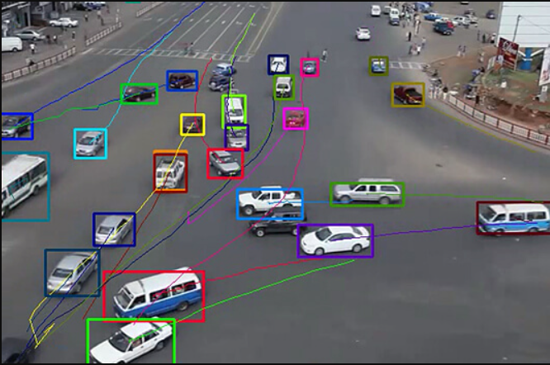
Introduction to Object Tracking
To track an object over a sequence of images.
Motive is to detect all known objects in a scene.
To determine Relative movements.

Slide 4
Problem Statement:
The objective is to detect and track the generic object in real time. In real life, therefore, we require rich information about the surrounding. We need to understand how the objects are moving with respect to the camera. It would also help to recognize the interaction between objects.
For example: How many cars have passed in a Lane.

Slide 5
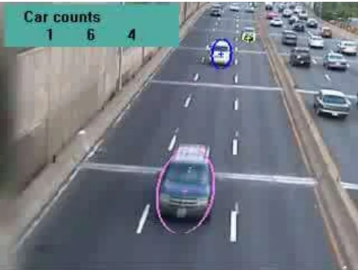
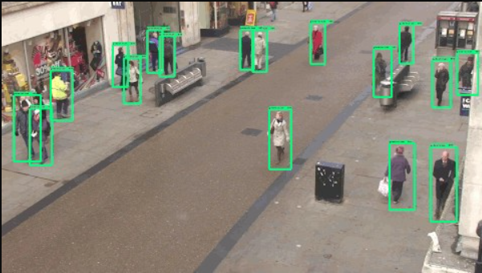
Applications of Object Tracking
Traffic Information and Surveillance

Slide 6
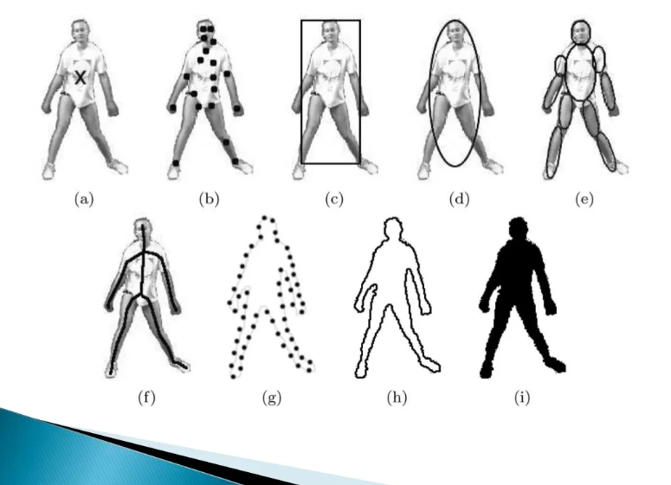
Object Representation
In a tracking scenario, objects can be represented by their shape. Object shape representations commonly employed for tracking are:
Points
Primitive geometric shapes.

Slide 7
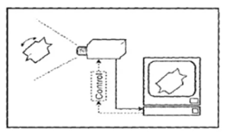
SCHEMATIC REPRESENTATION OF GENERIC OBJECT TRACKING SYSTEM
Visual input
Image Acquisation

Slide 8
OBJECT DETECTION
Every tracking method requires an object detection mechanism either in every frame or when the object first appears in the video.
Challenges of moving object detection:
Loss of information caused by the 3D world on a 2Dimage.
Noise in images.
Complex object motion
Non-rigid or articulated nature of objectsPartial or full object occlusions·
Complex object shapes
Scene illumination changes

Slide 9
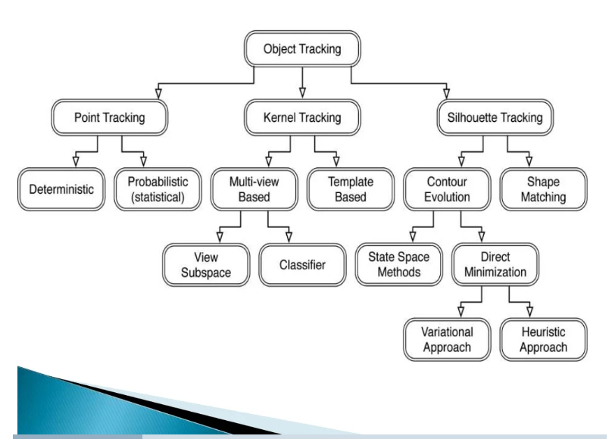

Slide 10
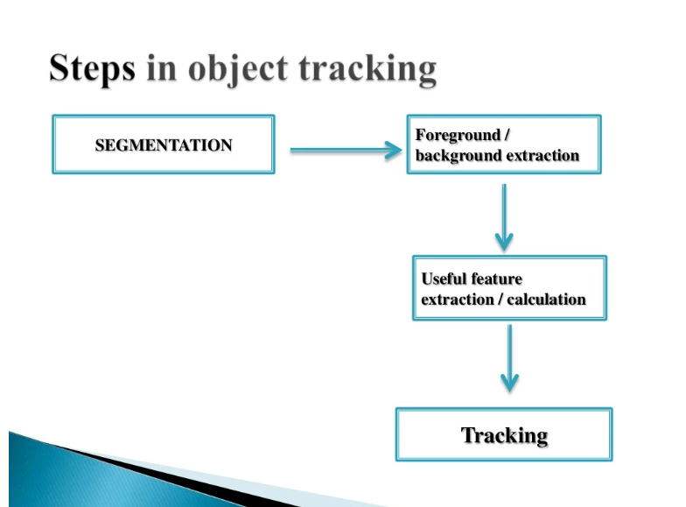

Slide 11
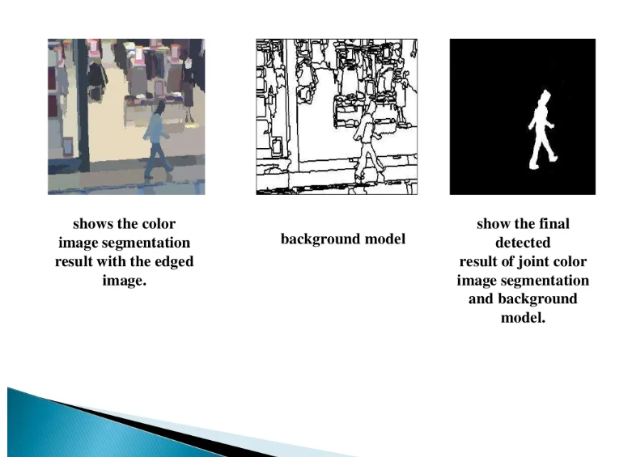

Slide 12
Object Tracking Algorithm’s

Slide 13
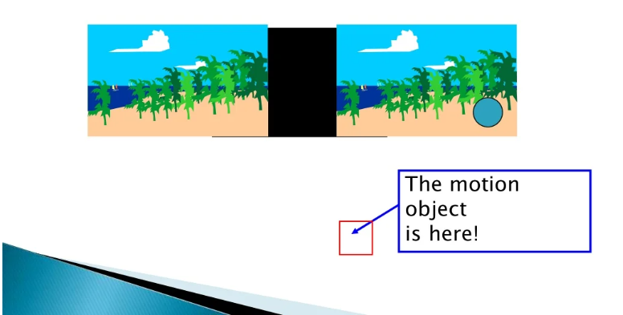
Object Tracking Algorithm
Different motion analysis method
SAD of consecutive frames
A threshold is set to detect the moving

Slide 14
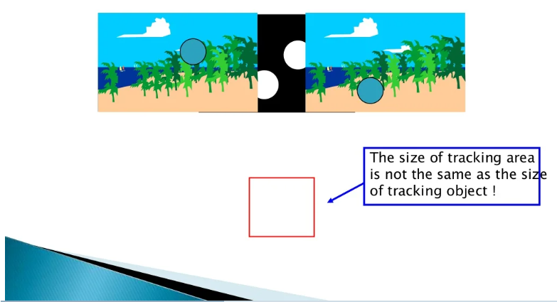
Object Tracking Algorithm
Disadvantage of DMA method
May include covered or covering background.

Slide 15
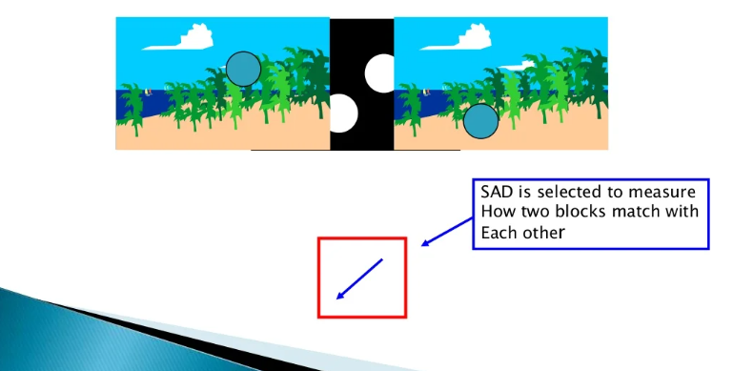
Object Tracking Algorithm
Solution:Block-Matching Algorithm
Using Motion vector to compensate the redundant part of tracking area.

Slide 16
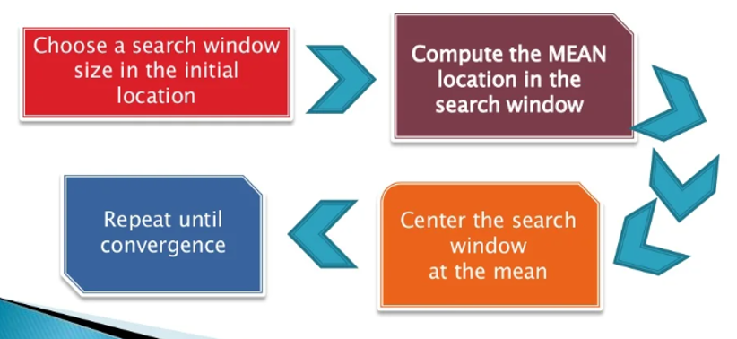
MEAN SHIFT ALGORITHM
A method that iteratively shifts the data point to the average of data points.

Slide 17
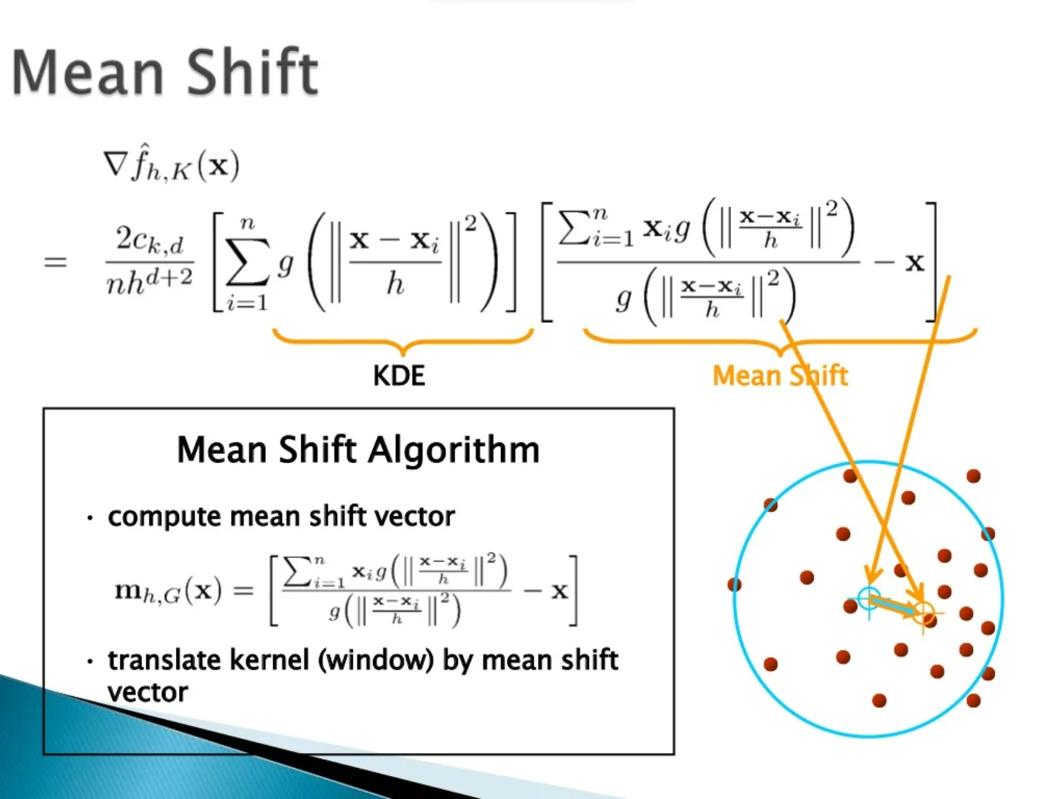

Slide 18
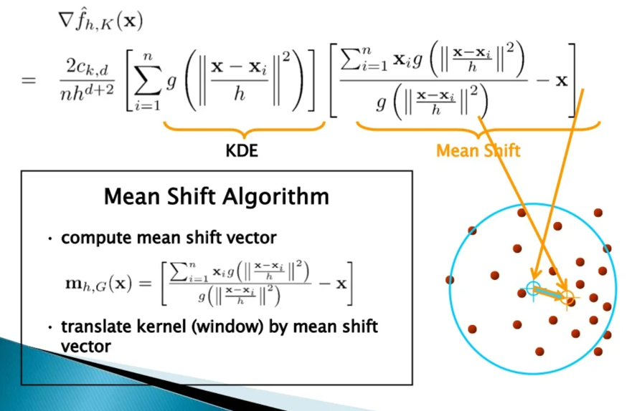
MEAN SHIFT

Slide 19
Working Example of Object Tracking
Code will be shown!

Slide 20
CONCLUSION
Object tracking means tracing the progress of objects as they move about in visual scene.
Object tracking, thus, involves processing spatial as well as temporal changes.
Significant progress has been made in object tracking.
Taxonomy of moving object detection is been proposed.
Performance of various object detection is also compared.

Slide 21
REFERENCES:
Athanesious, J. & Suresh, P., 2012. Systematic Survey on Object Tracking Methods in Video. Int. J. Adv. Res. Comput. Eng. Technol. 1, 242–247.
http://www.mathworks.in/help/vision/examples/motion -based-multiple-object-tracking.html
Comaniciu, D., Ramesh, V. & Meer, P., 2003. Kernel-based object tracking. IEEE Trans. Pattern Anal. doi:10.1109/TPAMI.2003.1195991 Mach. Intell. 25, 564–577.
Shoichi Arakil, Takashi Matsuoka, Haruo Takemura, and Naokazu Yokoya,Real-time Tracking of Multiple Moving Objects in Moving Camera Image Sequences Using Robust Statistics.1051-4651/98, 1998 IEEE.
http://unoccio.blogspot.in/2009/03/fast-color-based- object-tracking-using.html

Slide 22
THANK YOU !

